Slide 1

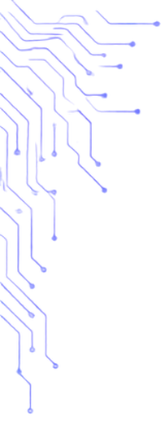















DEPARTMENT OF
COMPUTER SCIENCE
ALIGARH MUSLIM UNIVERSITY
INVITES
All Students of the Department
IT
FEST
TO
On
21st August 2026
CONNECT. CREATE. CODE.
TECH
EVENTS
WORKSHOPS
COMPETITIONS
CONNECT
Code | Debug | Solve
Learn | Build | Grow
Compete | Excel | Win
Network | Share | Inspire
BE PART OF THE BIGGEST TECH CELEBRATION
BY US, FOR US!
Register. Participate. Make it Memorable.
Visit website and book your seat:
www.amu.ac.in/cs_dept/it_fest
ONE DEPARTMENT. ONE SPIRIT. ENDLESS POSSIBILITIES

